Slide 1
Lecture 8
Sequential
Multipliers

Slide 2
Required Reading
Behrooz Parhami,
Computer Arithmetic: Algorithms and Hardware Design
Chapter 9, Basic Multiplication Scheme
Chapter 10, High-Radix Multipliers
Chapter 12.3, Bit-Serial Multipliers
Chapter 12.4, Modular Multipliers
Note errata at:
http://www.ece.ucsb.edu/~parhami/text_comp_arit_1ed.htm#errors

Slide 3
Required Reading
J-P. Deschamps, G. Bioul, G. Sutter,
Synthesis of Arithmetic Circuits: FPGA, ASIC and
Embedded Systems
Chapter 12.2.2.1, Booth-1 Multiplier
Chapter 12.2.2.2, Booth-2 Multiplier
Chapter 12.2.3, FPGA Implementation of the Booth-1
Multiplier
(handout distributed in class)

Slide 4
Notation
a Multiplicand a_{k-1}a_{k-2} . . . a₁ a₀
x Multiplier x_{k-1}x_{k-2} . . . x₁ x₀
p Product (a ⋅ x) p_{2k-1}p_{2k-2} . . . p₂ p₁ p₀
If multiplicand and multiplier are of different sizes,
usually multiplier has the smaller size

Slide 5
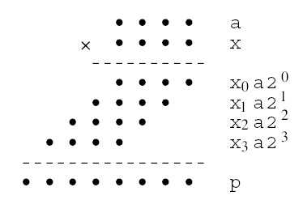
Multiplication of two 4-bit unsigned
binary numbers in dot notation
Partial Product 0
Partial Product 1
Partial Product 2
Partial Product 3
Number of partial products = number of bits in multiplier x
Bit-width of each partial product = bit-width of multiplicand a

Slide 6
Basic Multiplication Equations
k-1
x = ∑ x_{i} ⋅ 2^{i}
p = a ⋅ x
i=0
k-1
p = a ⋅ x = ∑ a ⋅ x_{i} ⋅ 2^{i} =
= x₀a2⁰ + x₁a2¹ + x₂a2² + … + x_{k-1}a2^{k-1}
i=0

Slide 7
Shift/Add Algorithm
Right-shift version

Slide 8
Shift/Add Algorithms
Right-shift algorithm
p = a ⋅ x = x₀a2⁰ + x₁a2¹ + x₂a2² + … + x_{k-1}a2^{k-1}
=
= (...((0 + x₀a2^{k})/2 + x₁a2^{k})/2 + ... + x_{k-1}a2^{k})/2 =
k times
p⁽⁰⁾ = 0
p^{(j+1)} = (p^{(j)} + x_{j} a 2^{k}) / 2
j=0..k-1
p = p^{(k)}

Slide 9
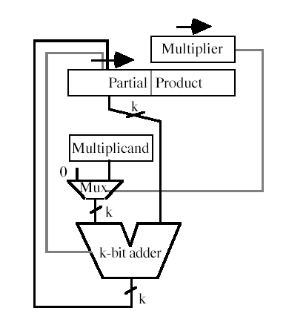
Sequential shift-and-add multiplier for
right-shift algorithm

Slide 10
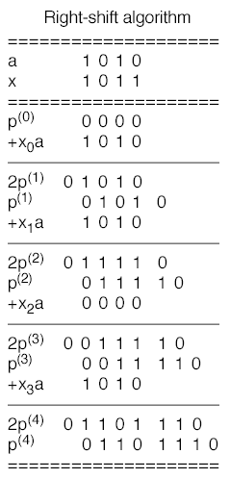
Right-shift
multiplication
algorithm:
Example

Slide 11
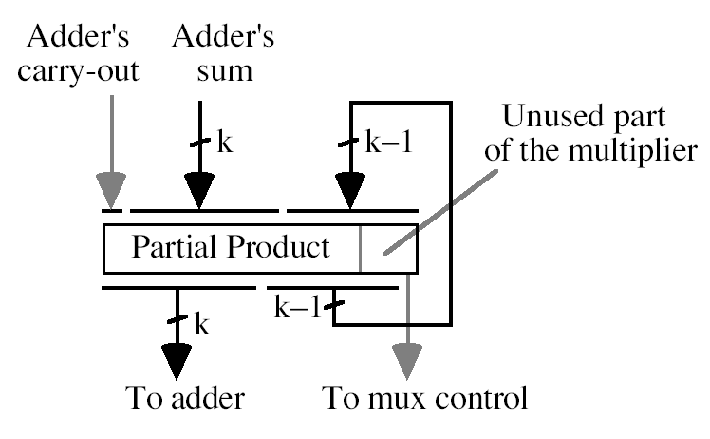
Area optimization for the sequential shift-and-add
multiplier with the right-shift algorithm

Slide 12
Shift/Add Algorithms
Right-shift algorithm: multiply-add
p⁽⁰⁾ = y2^{k}
p^{(j+1)} = (p^{(j)} + x_{j} a 2^{k}) / 2
j=0..k-1
p = p^{(k)}
= (...((y2^{k} + x₀a2^{k})/2 + x₁a2^{k})/2 + ... + x_{k-1}a2^{k})/2 =
k times
= y + x₀a2⁰ + x₁a2¹ + x₂a2² + … + x_{k-1}a2^{k-1} = y + a ⋅ x

Slide 13
Signed Multiplication
Previous sequential multipliers are for unsigned multiplication
For signed multiplication:
  assume sign-extended operation for p^{(j)} + x_{j}a
  if 2's complement multiplier is POSITIVE
    right-shift sequential algorithms (shift-add) will work directly
  if 2's complement multiplier is NEGATIVE than we must use "negative weight” for x_{k-1} and subtract x_{k-1}a in the last cycle
Slight increase in area due to control and one-bit sign extension on inputs of adder
  Unsigned: k bit number + k bit number → k+1 bit number
  Signed: k+1 bit sign extended number + k+1 bit sign extended number → k+1 bit number

Slide 14
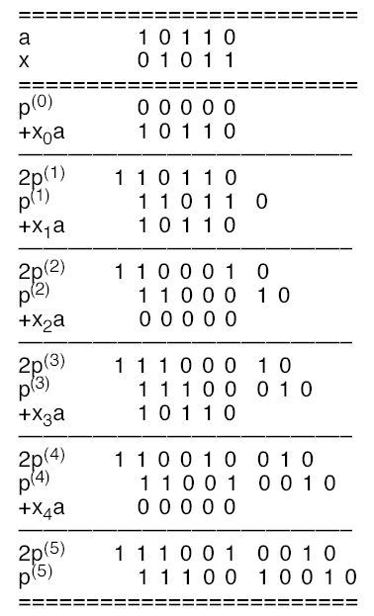
Sequential
multiplication
of 2’s-complement
numbers
with right shifts
(positive multiplier)

Slide 15
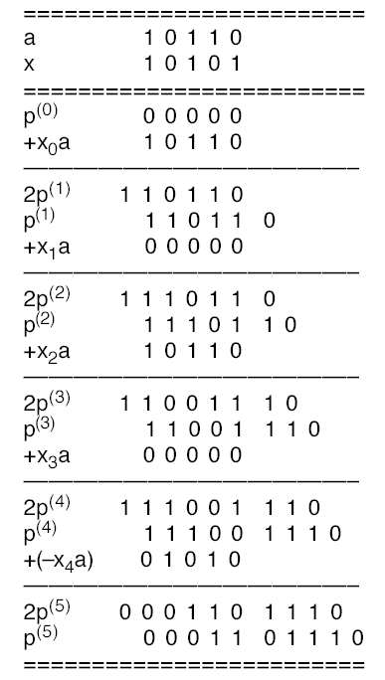
Sequential
multiplication
of 2’s-complement
numbers
with right shifts
(negative multiplier)

Slide 16
Shift/Add Algorithm
Left-shift version

Slide 17
Shift/Add Algorithms
Left-shift algorithm
p = a ⋅ x = x₀a2⁰ + x₁a2¹ + x₂a2² + … + x_{k-1}a2^{k-1}
=
= (...((0⋅2 + x_{k-1}a)⋅2 + x_{k-2}a)⋅2 + ... + x₁a)⋅2 + x₀a=
k times
p⁽⁰⁾ = 0
p^{(j+1)} = (p^{(j)} ⋅2 + x_{k-1-j}a)
j=0..k-1
p = p^{(k)}

Slide 18
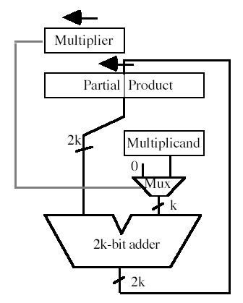
Sequential shift-and-add multiplier for
left-shift algorithm
Left shifts are not as efficient for
two's complement because must
sign extend multiplicand by k bits

Slide 19
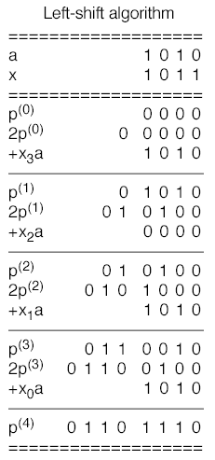
Left-shift
multiplication
algorithm:
Example

Slide 20
Shift/Add Algorithms
Left-shift algorithm: multiply-add
p⁽⁰⁾ = y2^{-k}
p^{(j+1)} = (p^{(j)} ⋅2 + x_{k-(j+1)}a)
j=0..k-1
p = p^{(k)}
= (...((y2^{-k} ⋅2 + x_{k-1}a)⋅2 + x_{k-2}a)⋅2 + ... + x₁a)⋅2 + x₀a =
k times
= y + x_{k-1}a2^{k-1} + x_{k-2}a2^{k-2} + … + x₁a2¹ + x₀a = y + a ⋅ x

Slide 21
High-Radix
Sequential Multipliers

Slide 22
High-Radix Notation
a Multiplicand (a_{k-1}a_{k-2} . . . a₁ a₀)_{r}
x Multiplier (x_{k-1}x_{k-2} . . . x₁ x₀)_{r}
p Product (a ⋅ x) (p_{2k-1}p_{2k-2} . . . p₂ p₁ p₀)_{r}

Slide 23
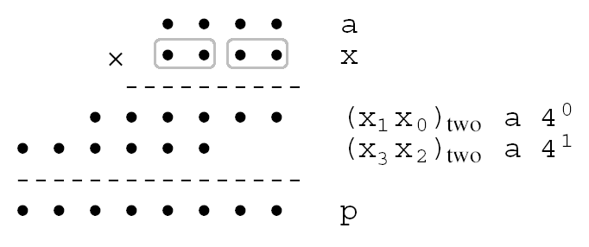
Radix-4, or two-bit-at-a-time,
multiplication in dot notation

Slide 24
Basic Multiplication Equations
k-1
x = ∑ x_{i} ⋅ r^{i}
p = a ⋅ x
i=0
k-1
p = a ⋅ x = ∑ a ⋅ x_{i} ⋅ r^{i} =
= x₀ar⁰ + x₁a r¹ + x₂a r² + … + x_{k-1}a r^{k-1}
i=0

Slide 25
High-Radix Shift/Add Algorithms
Right-shift high-radix algorithm
p = a ⋅ x = x₀ar⁰ + x₁ar¹ + x₂ar² + … + x_{k-1}ar^{k-1}
=
= (...((0 + x₀ar^{k})/r + x₁ar^{k})/r + ... + x_{k-1}ar^{k})/r =
k times
p⁽⁰⁾ = 0
p^{(j+1)} = (p^{(j)} + x_{j} a r^{k}) / r
j=0..k-1
p = p^{(k)}

Slide 26
High-Radix Shift/Add Algorithms
Left-shift high-radix algorithm
p = a ⋅ x = x₀ar⁰ + x₁ar¹ + x₂ar² + … + x_{k-1}ar^{k-1}
=
= (...((0⋅r + x_{k-1}a)⋅r + x_{k-2}a)⋅r + ... + x₁a)⋅r + x₀a=
k times
p⁽⁰⁾ = 0
p^{(j+1)} = (p^{(j)} ⋅ r + x_{k-1-j}a)
j=0..k-1
p = p^{(k)}

Slide 27
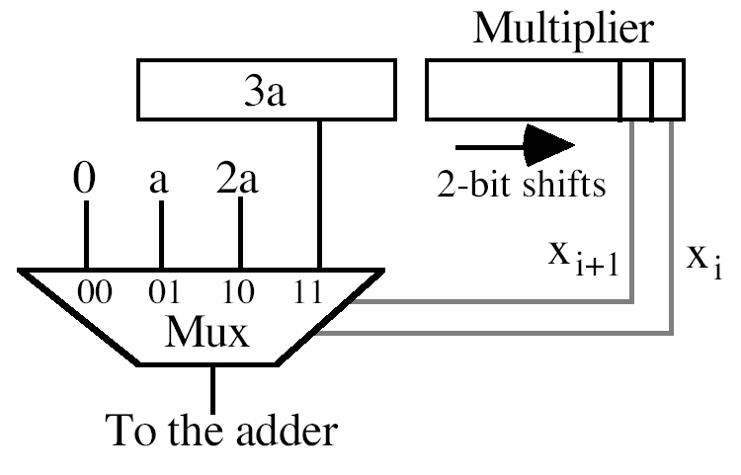
The multiple generation part of a radix-4
multiplier with precomputation of 3a

Slide 28
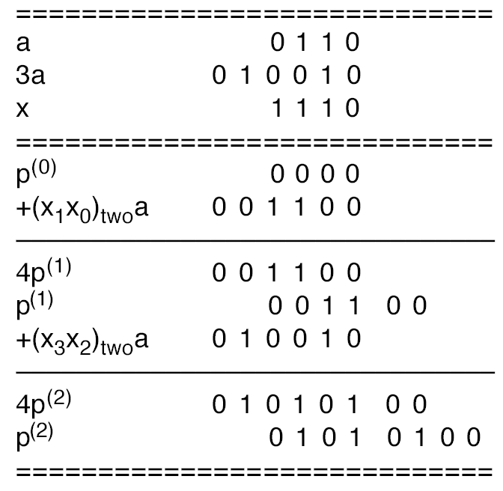
Example of radix-4 multiplication
using the 3a multiple

Slide 29
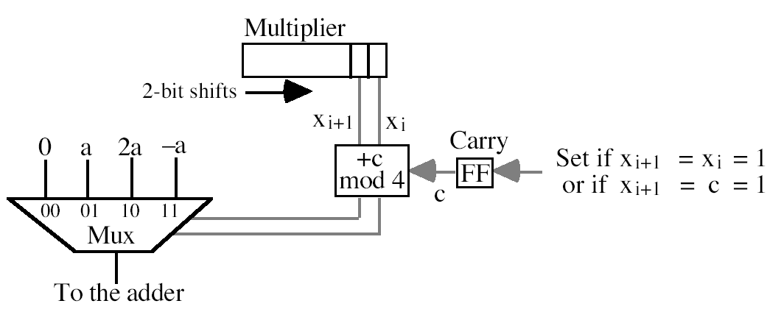
The multiple generation part of a radix-4
multiplier based on replacing 3a with 4a
(carry into next higher radix-4 multiplier
digit) and -a

Slide 30
Higher Radix Multiplication
In radix-8, one must precompute 3a, 5a, 7a
  Overhead becomes prohibitive and does not help
However, when we discuss CSA this may be useful

Slide 31
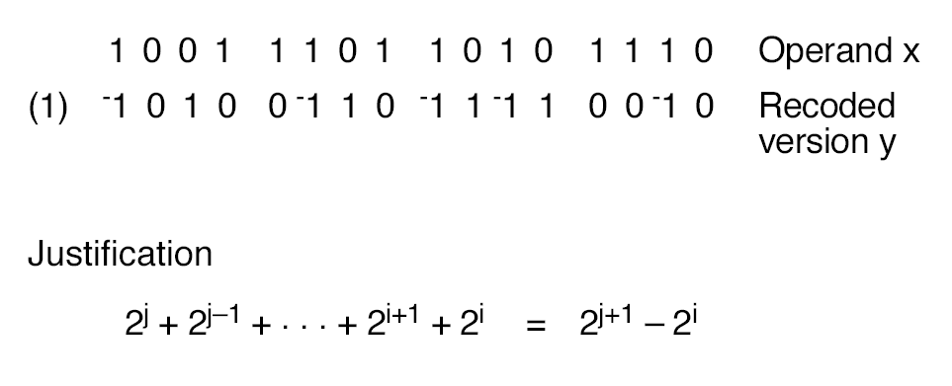
Radix-2 Booth Recoding
j+1
j
i

Slide 32
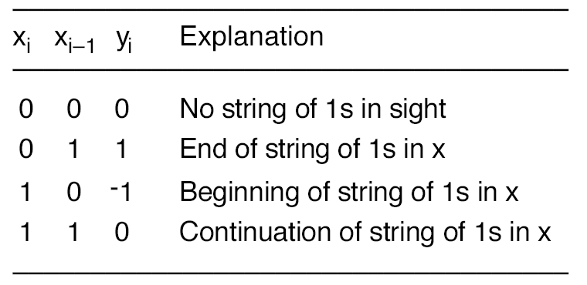
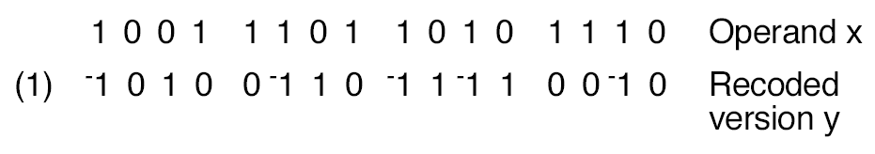
Radix-2 Booth Recoding
y_{i} = -x_{i} + x_{i-1}

Slide 33
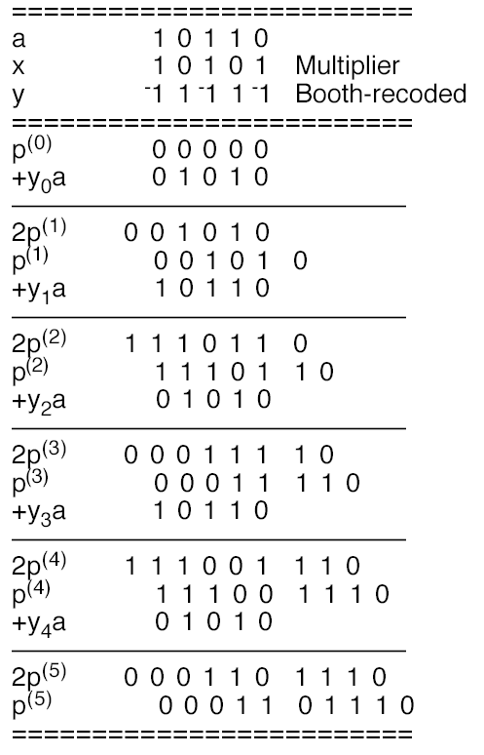
Sequential
multiplication of
2’s-complement
numbers with
right shifts using
Booth’s recoding

Slide 34
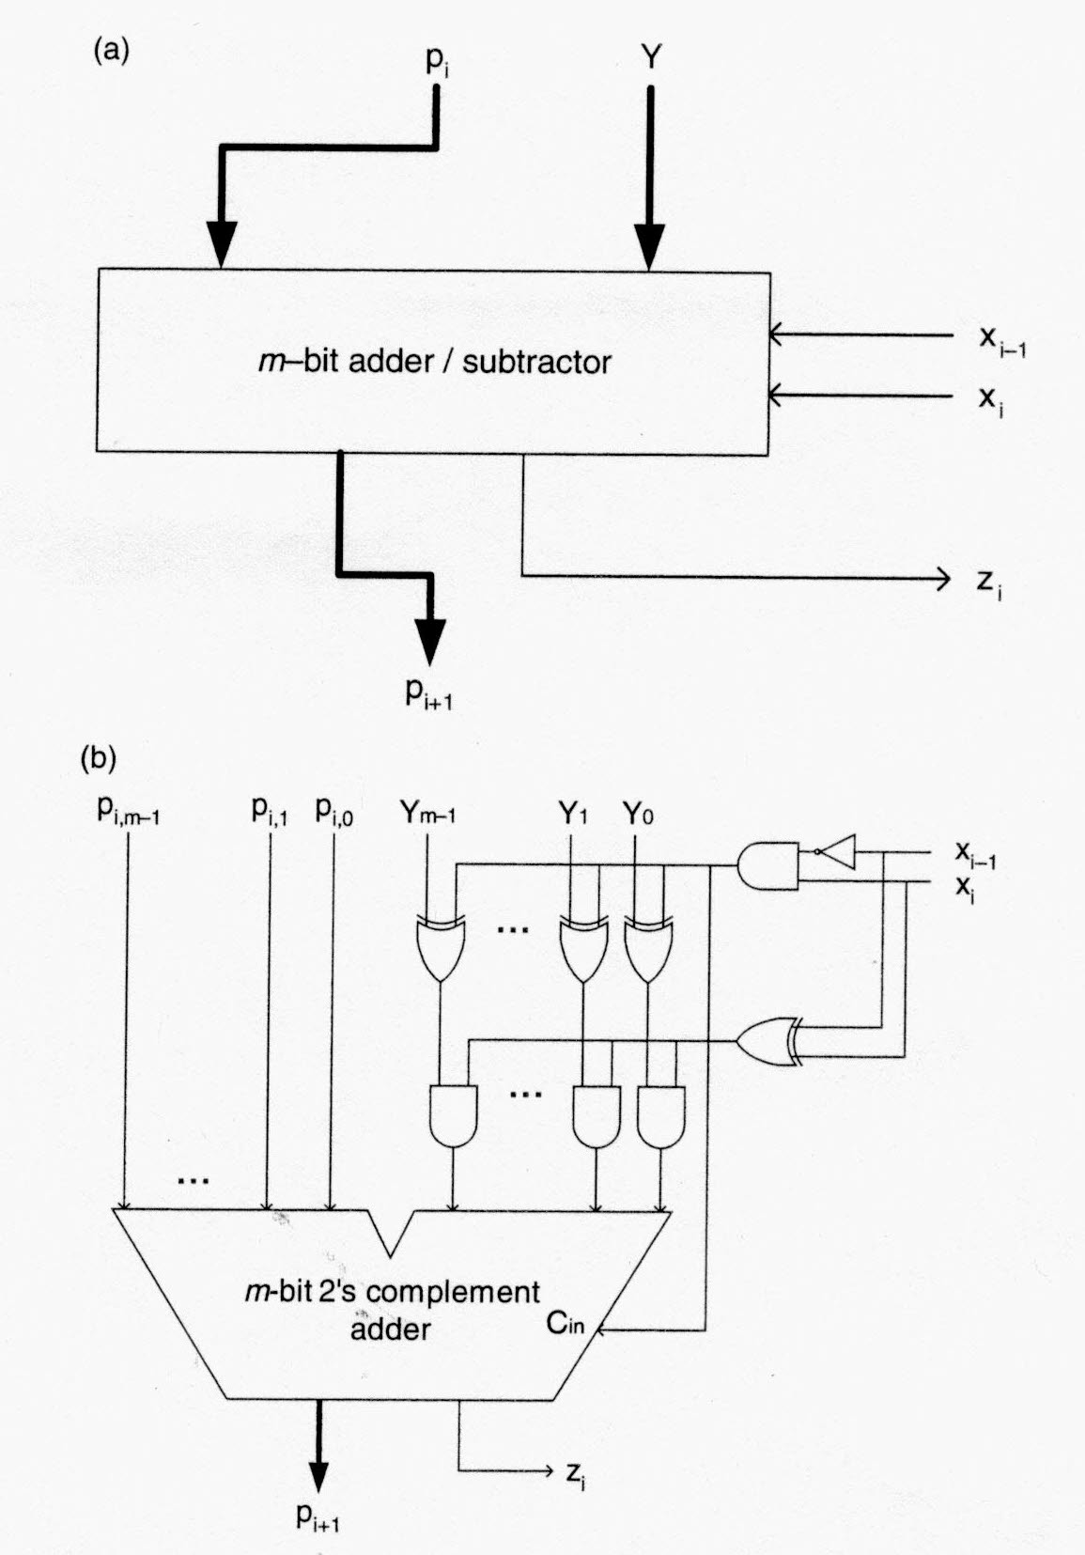
Radix-2 Booth
Multiplier
Basic Step

Slide 35
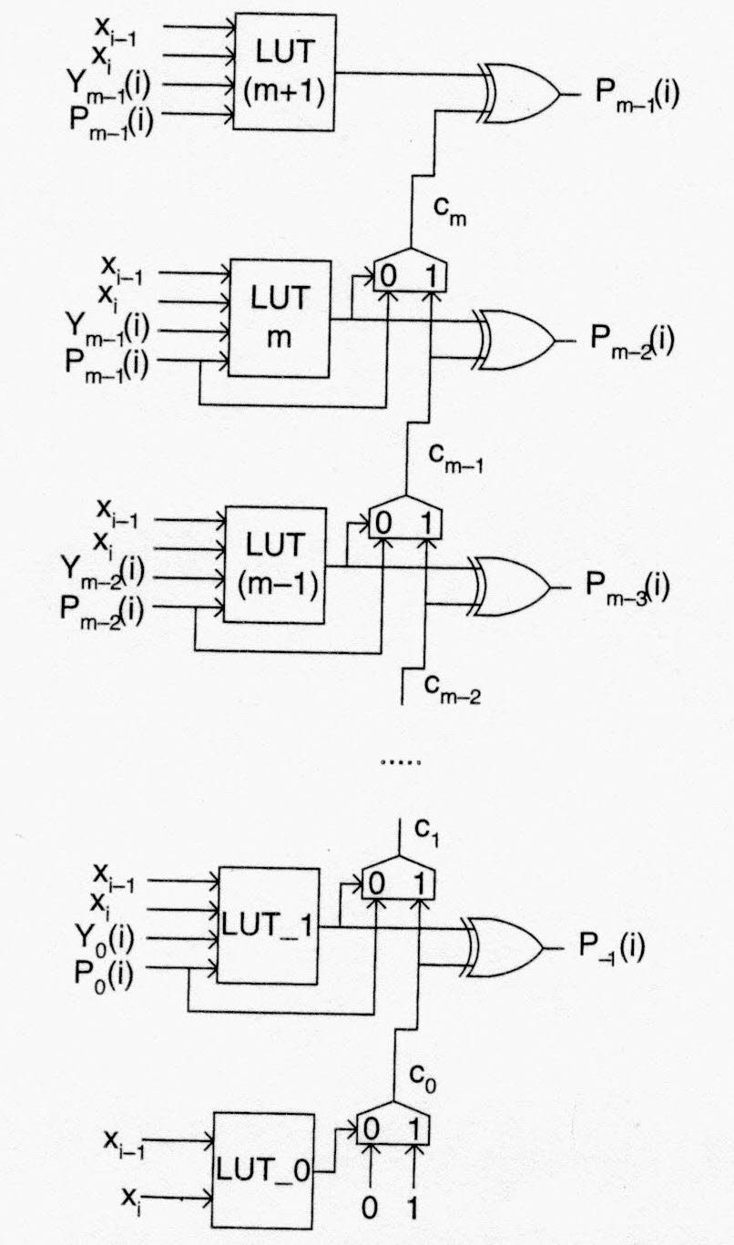
Radix-2 Booth
Multiplier
Basic Step
in Xilinx FPGAs

Slide 36
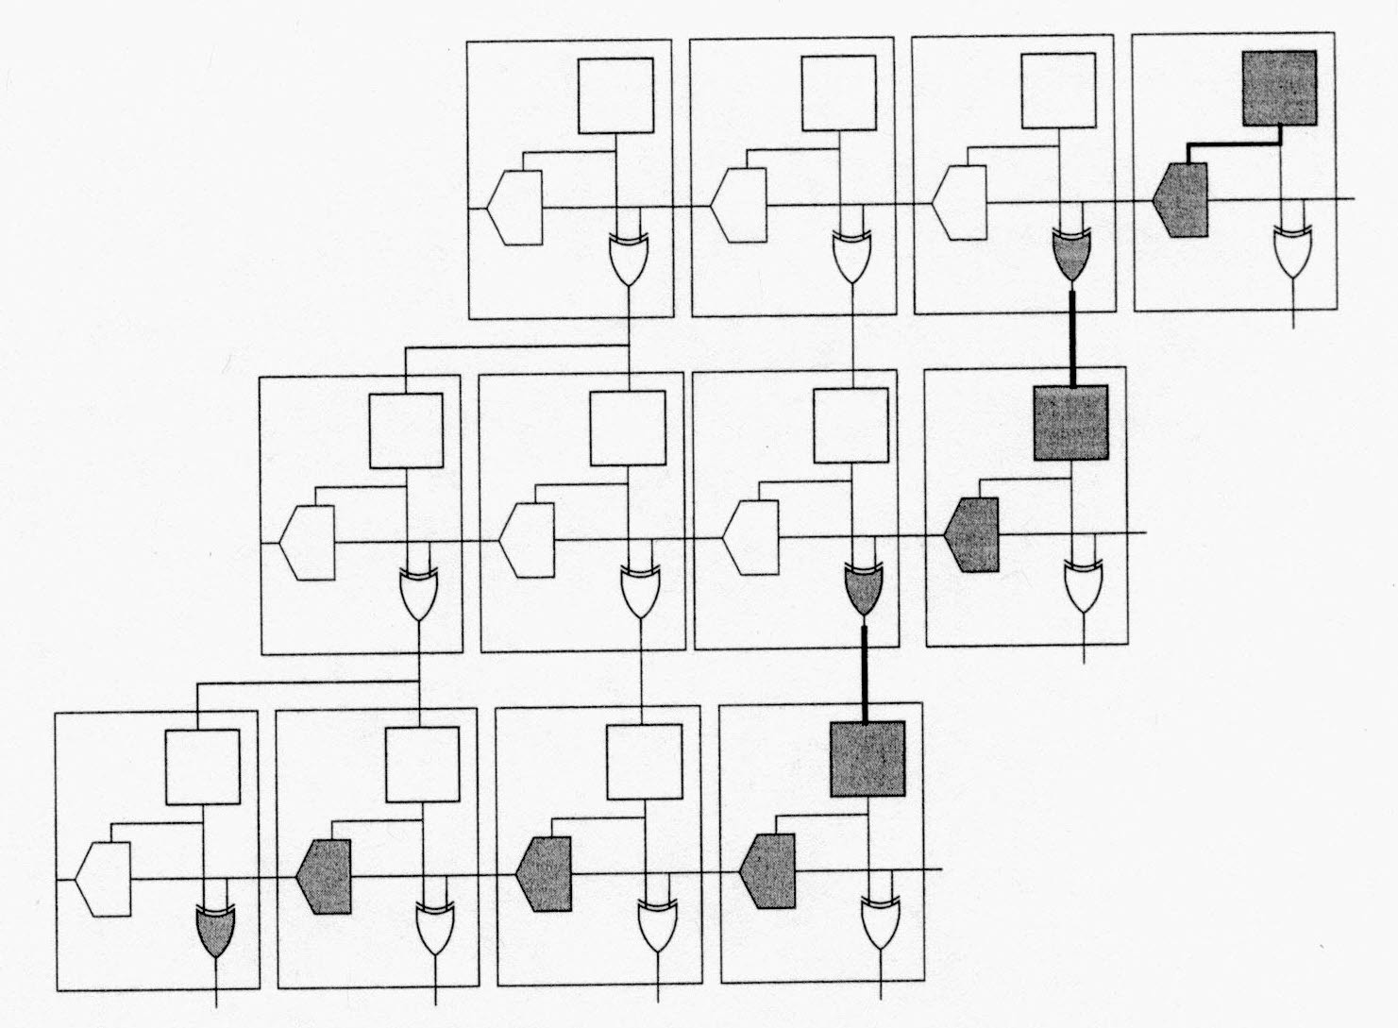
Radix-2 Booth Multiplier
in Xilinx FPGAs

Slide 37

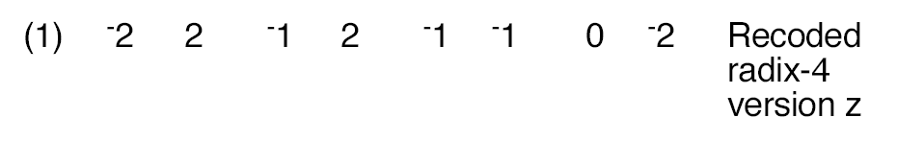
Radix-4 Booth Recoding
(1) -1 0 1 0 0 -1 1 0 -1 1 -1 1 0 0 -1 0

Slide 38
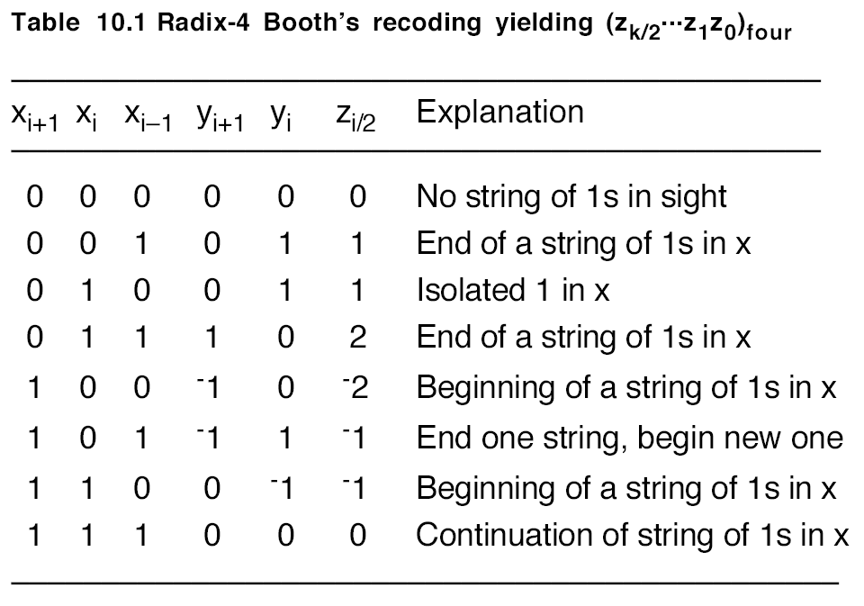
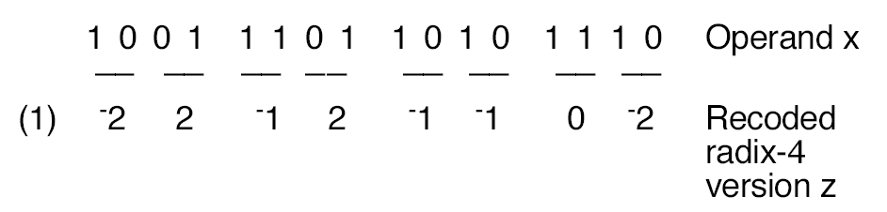
z_{i/2} = -2x_{i+1} + x_{i} + x_{i-1}

Slide 39
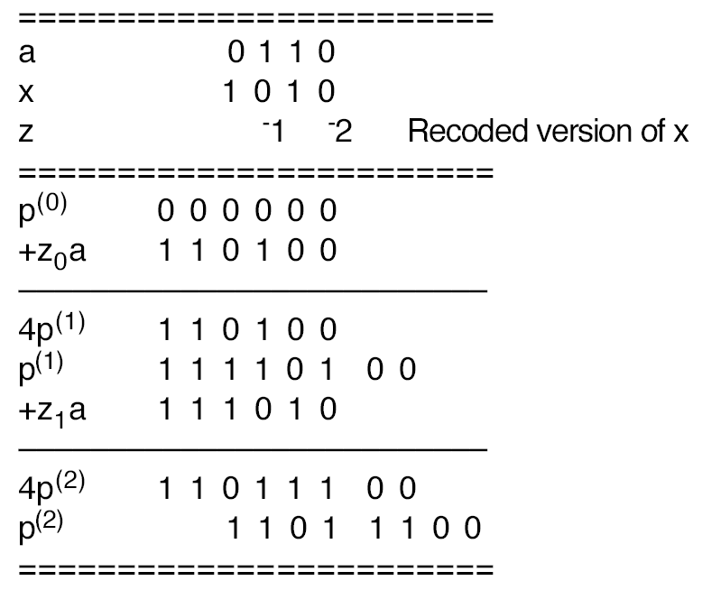
Example radix-4 multiplication with modified
Booth’s recoding of the 2’s-complement
multiplier

Slide 40
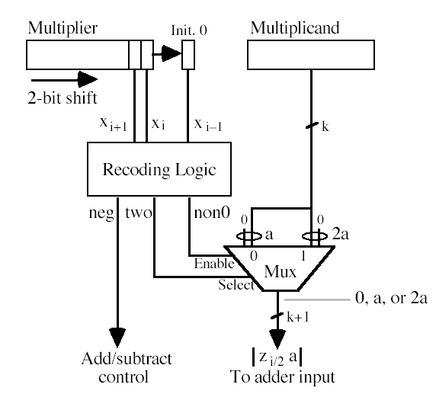
The multiple generation part of a radix-4
multiplier based on Booth’s recoding

Slide 41
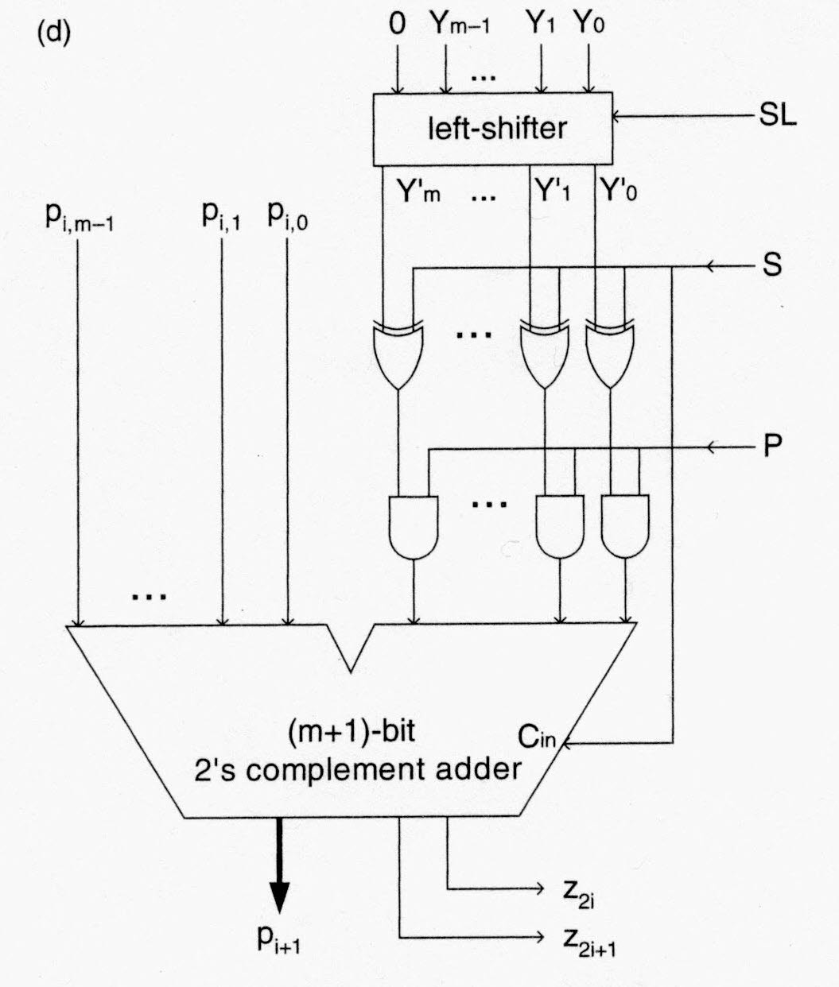
Radix-4 Booth
Multiplier
Basic Step

Slide 42
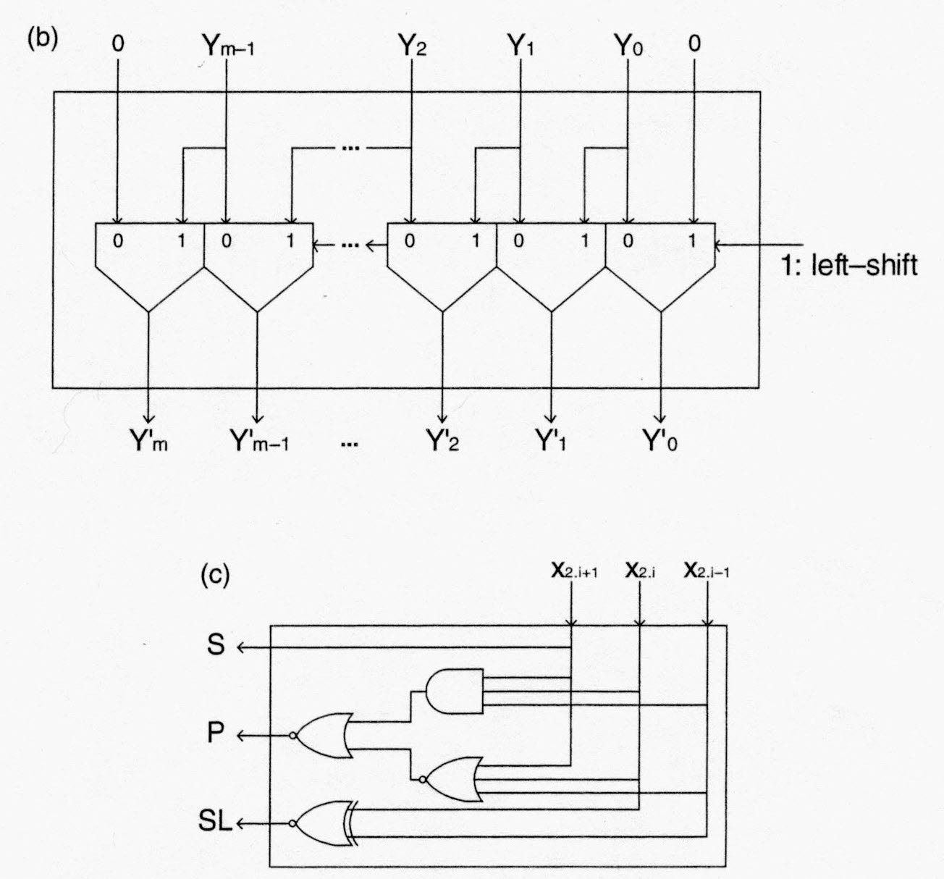
Radix-4 Booth Multiplier:
Left Shifter & Control

Slide 43
Shift/Add Algorithm
Right-shift version
with Carry-Save Adder

Slide 44
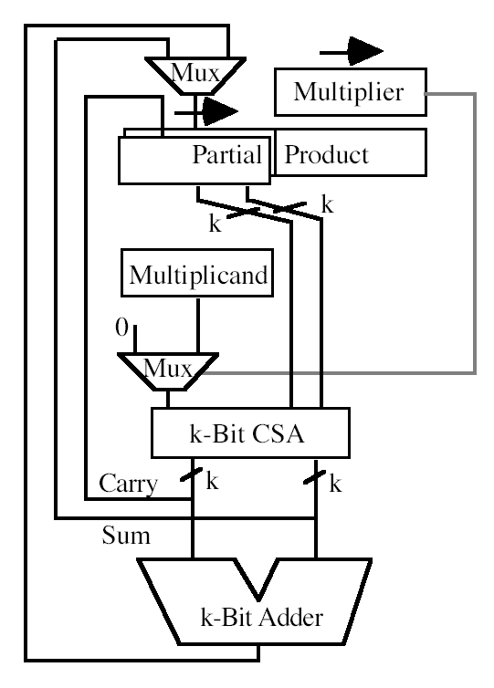
Sequential shift-and-add multiplier
with a carry save adder

Slide 45
High-Radix Multipliers
with Carry-Save Adder

Slide 46
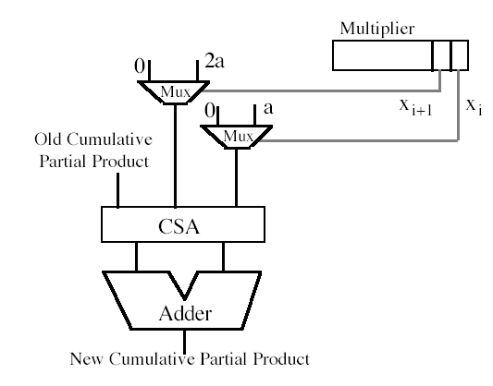
Radix-4 multiplication with a carry-save adder
used to combine the
cumulative partial product, x_{i}a, and 2x_{i+1}a
into two numbers

Slide 47
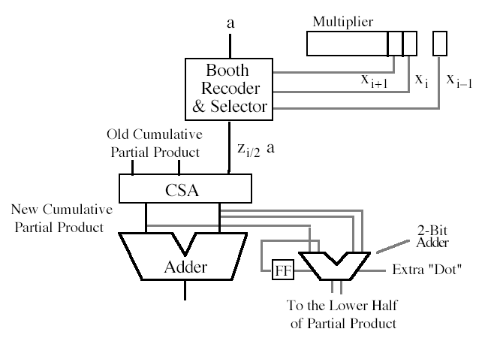
Radix-4 multiplier with
a carry-save adder and Booth’s recoding

Slide 48
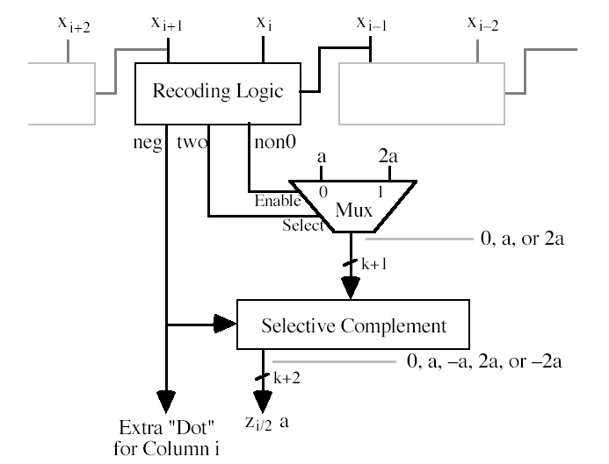
Booth recoding and multiple selection logic
for high-radix multiplication

Slide 49
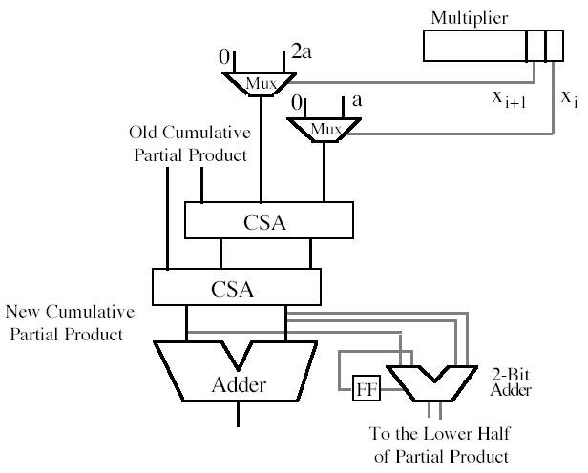
Radix-4 multiplier with
two carry-save adders

Slide 50
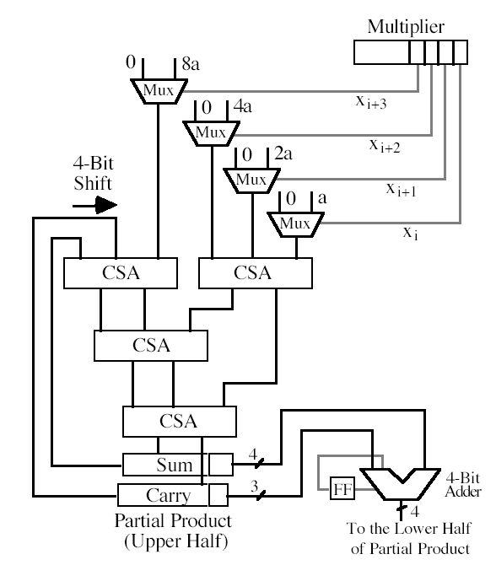
Radix-16 multiplier with carry-save adders

Slide 51
Bit-Serial Multipliers

Slide 52
Bit Serial Multipliers
Advantages
small area
reduced pin count
reduced wire length
high clock rate

Slide 53
Systolic Array
Systolic array: synchronous arrays of processing elements that are interconnected by only short, local wires thus allowing very high clock rates

Slide 54
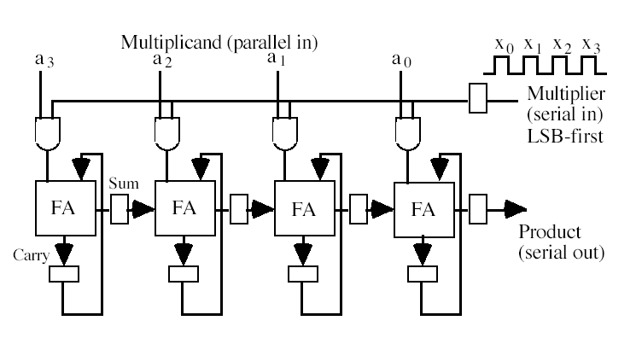
Semisystolic Bit-Serial Multiplier (1)

Slide 55
Semisystolic Bit-Serial Multiplier (2)
a₃x₀ a₂x₀ a₁x₀ a₀x₀
a₃x₁ a₂x₁ a₁x₁ a₀x₁
p₀
a₃x₂ a₂x₂ a₁x₂ a₀x₂
p₁
a₃x₃ a₂x₃ a₁x₃ a₀x₃
p₂
a₃ 0 a₂ 0 a₁ 0 a₀ 0
p₃
a₃ 0 a₂ 0 a₁ 0 a₀ 0
p₄
a₃ 0 a₂ 0 a₁ 0 a₀ 0
p₅
a₃ 0 a₂ 0 a₁ 0 a₀ 0
p₆
p₇

Slide 56
Retiming
k
k
d
k+n+d
k+n
k+d
d
k
k+d+n
k+d+n

Slide 57
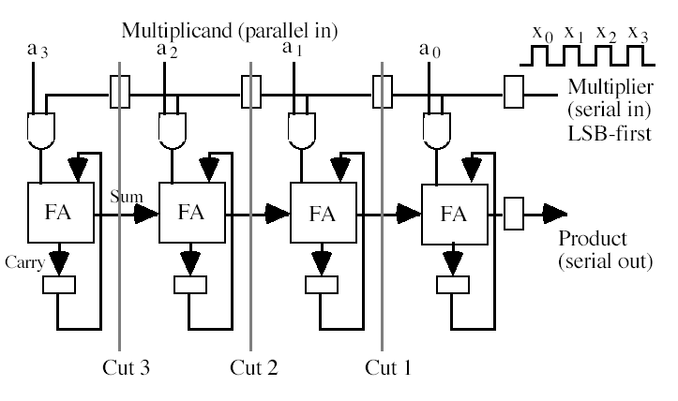
Retimed Semisystolic
Bit-Serial Multiplier (1)

Slide 58
Retimed Semisystolic
Bit-Serial Multiplier (2)
a₃ 0 a₂ 0 a₁ 0 a₀x₀
p₀
a₃ 0 a₂ 0 a₁x₀ a₀x₁
p₁
a₃ 0 a₂x₀ a₁x₁ a₀x₂
p₂
a₃x₀ a₂x₁ a₁x₂ a₀x₃
p₃
a₃ x₁ a₂x₂ a₁x₃ a₀ 0
p₄
a₃ x₂ a₂x₃ a₁ 0 a₀ 0
p₅
a₃x₃ a₂ 0 a₁ 0 a₀ 0
p₆
a₃ 0 a₂ 0 a₁ 0 a₀ 0
p₇

Slide 59
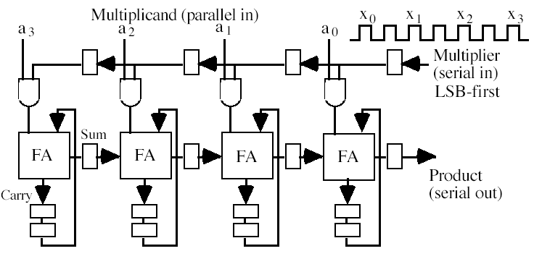
Systolic Bit-Serial Multiplier

Slide 60
Modular Multipliers

Slide 61
Modular Multiplication
Special Cases
k bits
a
a
a x
= p = p_{H} 2^{k} + p_{L}
x
x
p_{H}
p_{L}
p
a x mod 2^{k} = p_{L}
a x mod 2^{k}-1 = p_{L} + p_{H} + carry
a x mod 2^{k}+1 = p_{L} - p_{H} - borrow

Slide 62
Modular Multiplication
Special Case (1)
a x mod 2^{k}-1 = (p_{H} 2^{k} + p_{L}) mod (2^{k}-1) =
= (p_{H} (2^{k} mod (2^{k}-1)) + p_{L}) mod (2^{k}-1) =
= p_{H} + p_{L} mod (2^{k}-1) =
=
p_{H} + p_{L} if p_{H} + p_{L} < 2^{k} - 1
p_{H} + p_{L} - (2^{k}-1) if p_{H} + p_{L} ≥ 2^{k} - 1
=
p_{L} + p_{H} + carry
carry = carry from addition p_{L} + p_{H}

Slide 63
Modular Multiplication
Special Case (2)
a x mod 2^{k}+1 = (p_{H} 2^{k} + p_{L}) mod (2^{k}+1) =
= (p_{H} (2^{k}+1-1) + p_{L}) mod (2^{k}+1) =
= p_{L} - p_{H} mod (2^{k}+1) =
=
p_{L} - p_{H} if p_{L} - p_{H} ≥ 0
p_{L} - p_{H} + (2^{k}+1) if p_{L} - p_{H} < 0
=
p_{L} - p_{H} + borrow
borrow = borrow from subtraction p_{L} + p_{H}

Slide 64
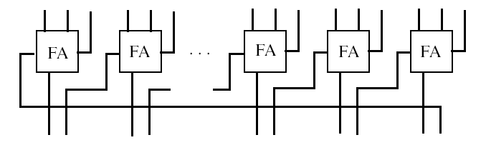
Modulo (2^{b}-1) Carry Save Adder

Slide 65
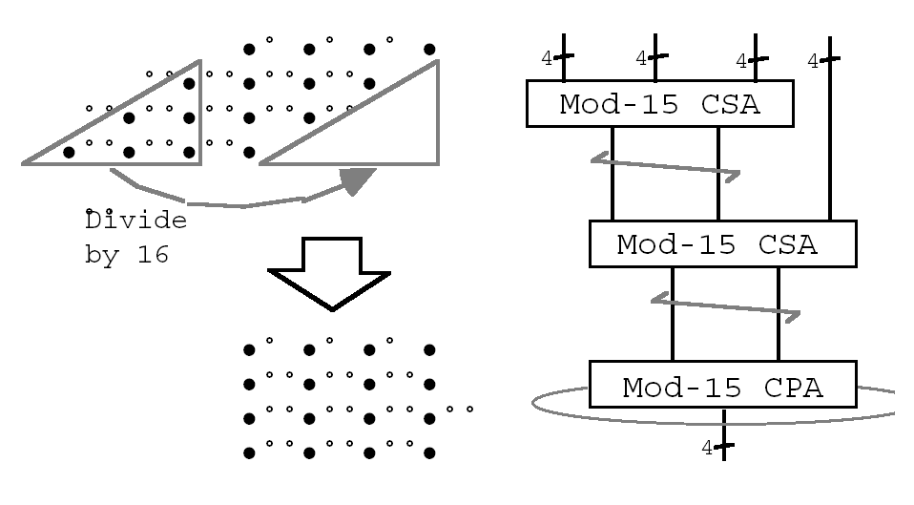
4 x 4 Modulo 15 Multiplier

Slide 66
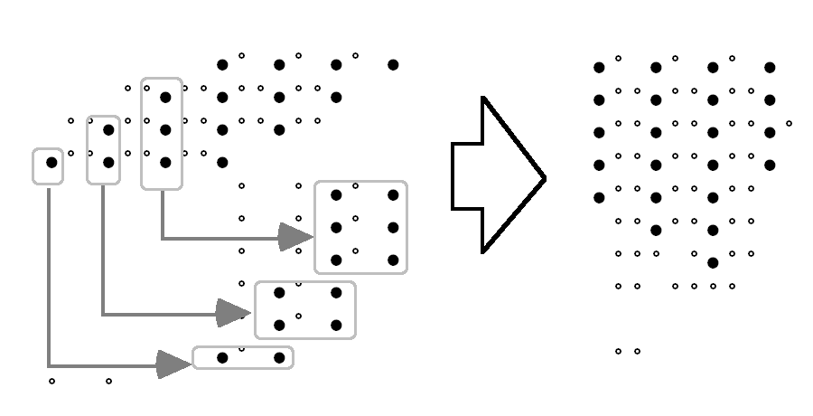
4 x 4 Modulo 13 Multiplier

